Slide 1

第五章作业

Slide 2










目录

Slide 3

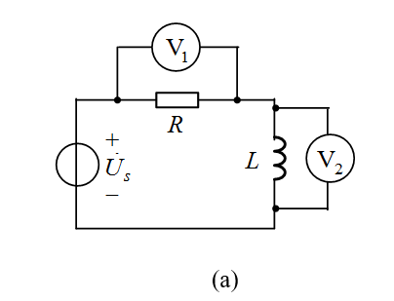
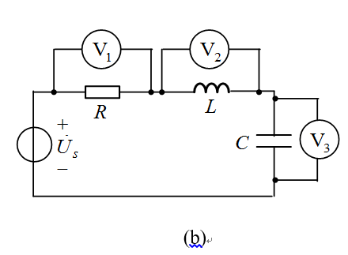

Slide 4

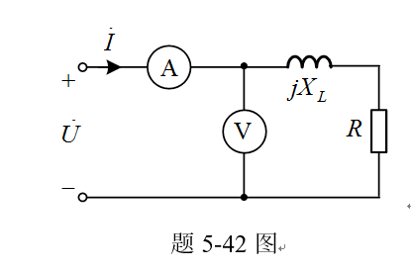

Slide 5

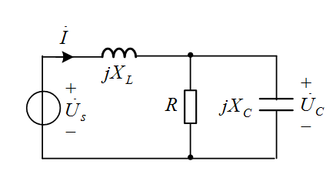

Slide 6

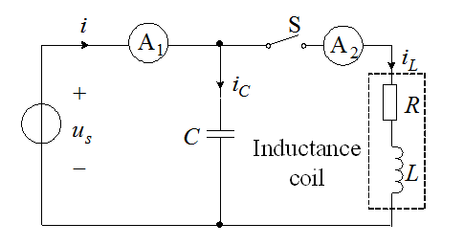

Slide 7

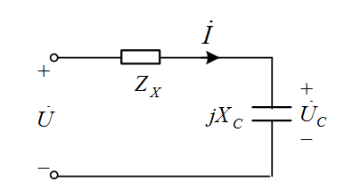

Slide 8

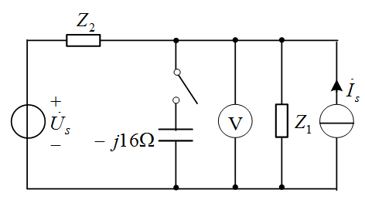

Slide 9


Slide 10
5-63 There are 50 fluorescent lamps (inductive) with power of 60W and power factor of 0.5 and 50 incandescent lamps with power of 100W, which are connected in parallel with the sinusoidal power supply of 220V (F = 50 Hz). If the power factor of the circuit is to be increased to 0.92, calculated the value of the shunt capacitor?

Slide 11


Slide 12





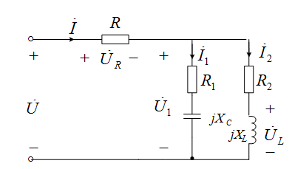

Slide 13
谢谢!

